Slide 1
Part one
Dr.Widad

Slide 7
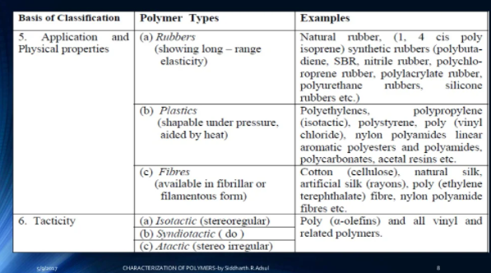

Slide 8
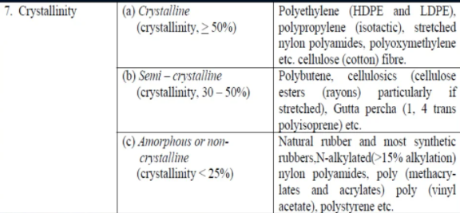

Slide 12
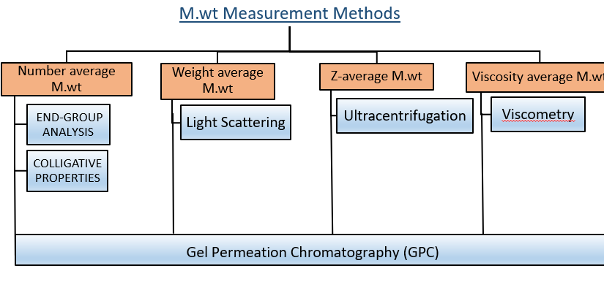
Molecular Weight
Widad.salih
9\3\2022

Slide 14
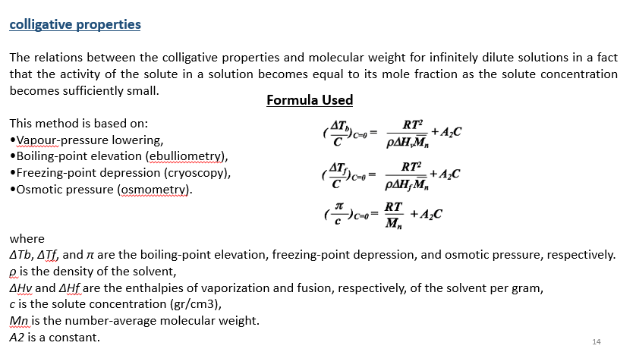

Slide 15
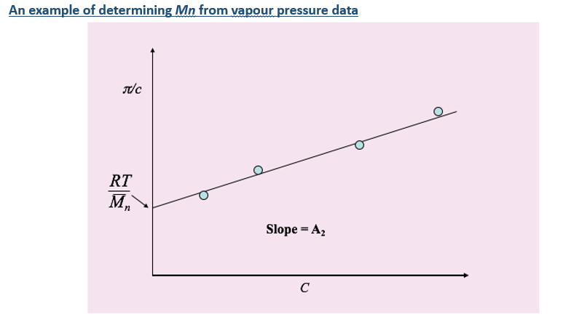

Slide 19
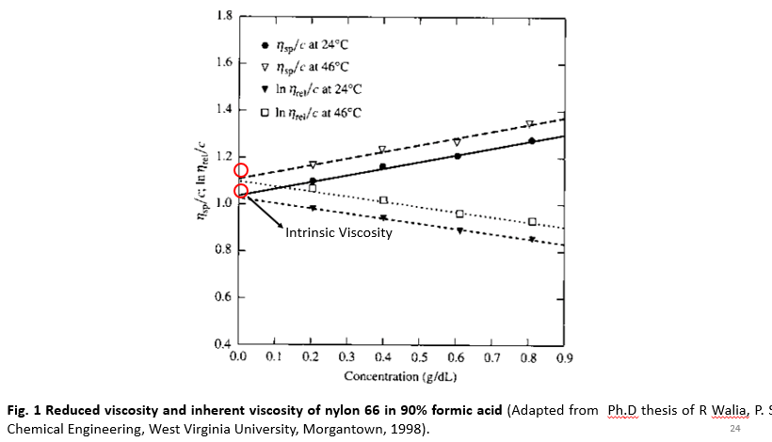

Slide 20
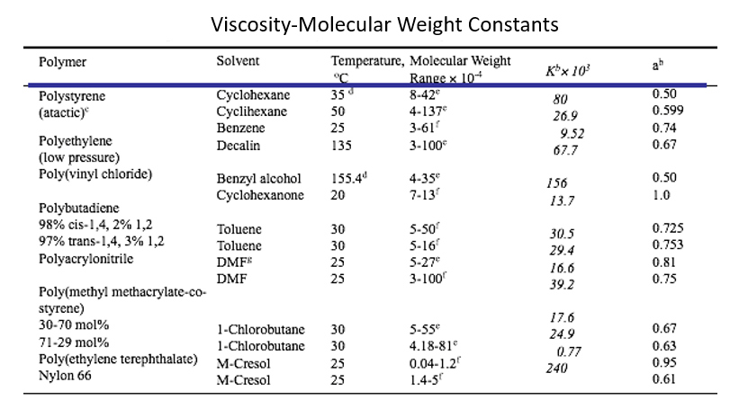

Slide 22
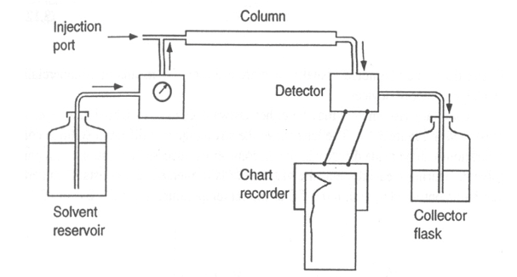

Slide 23
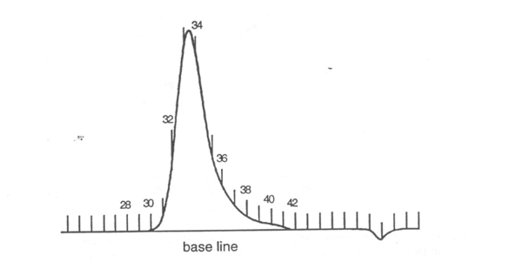

Slide 24
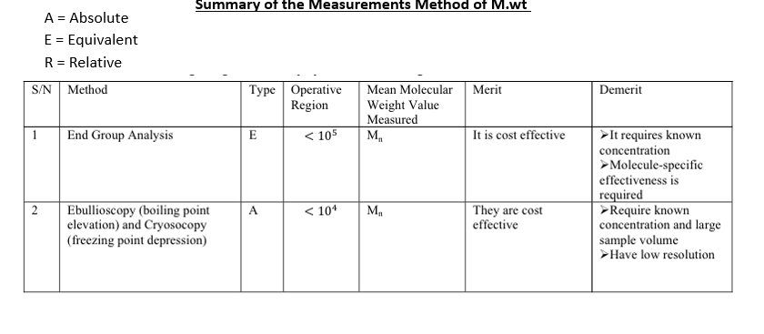

Slide 25
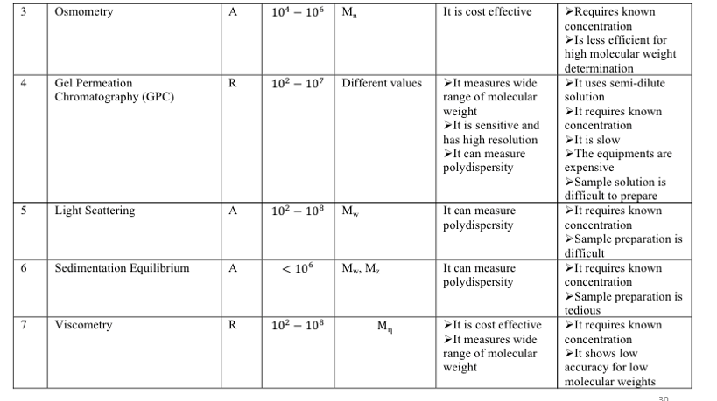

Slide 26
Characterization of Polymers using Thermal Analysis ( TGA,DSC )
The importance of polymers in our daily lives has not come about arbitrarily, but rather as a result of the distinct advantages that they offer. These advantages include:-
Low density, Light Weight, Good thermal and electric insulator , resistance to corrosion effect, chemical resistance, good coloring , dimensional stability , absorption of mechanical shock

Slide 27
Crystallization Behavior of Semi crystalline PET
Polyethylene terephthalate (PET) is a semi-crystalline thermoplastic polymer with a relatively slow crystallization rate. High cooling rates lead to a high amorphous content, high glass transition steps (Tg) and post-crystallization during heating.
Low cooling rates allow more crystalline parts to crystallize during cooling, leading to a smaller glass transition step and no post-crystallization. The material then has an increased crystallinity and therefore loses its transparency.
Enthalpy (exo/endothermal DSC effects) or mass loss (TGA)
∙Reaction type
∙Activation energy
∙Pre-exponential factor
∙Order of reaction
∙Order of autocatalysis
∙Additional kinetic parameters

Slide 28
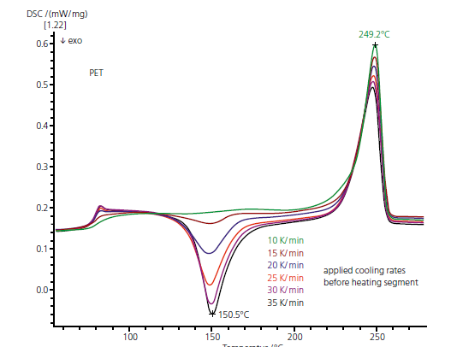

Slide 29
Influence of Atmospheric Moisture
Polyamides absorb atmospheric moisture, which affects their mechanical properties.
The endothermic peak at -28 C 1st heating (red curve) indicates the glass transition of the moist PA6. The endothermic effect between 20°C and 180°C is due to the evaporation of water contained in the sample. In the 2nd heating, the sample is dry and the glass transition temperature is shifted to 55°C. Water acts as a plasticizer and lowers the glass transition temperature. The peaks at 225°C (1st heating) and 220°C (2nd heating) are related to melting. The 2nd heating additionally shows a cold crystallization at 196°C.

Slide 30
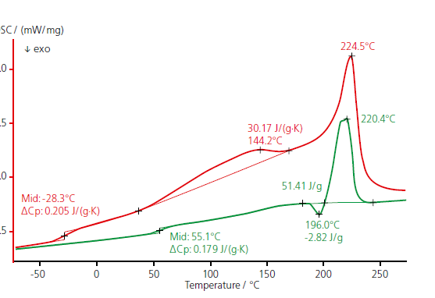

Slide 31
Plasticizer Influence on the Cold Flexibility
Plasticizers or dispersants are additives which increase the plasticity or fluidity of a material. When cooled below the glass transition temperature,
These measurements were carried out on three NBR samples differing in their plasticizer content. It can be observed that modification of the NBR plasticizer content yields different glass transition temperatures. The cold flexibility can be improved by increasing the plasticizer content.

Slide 32
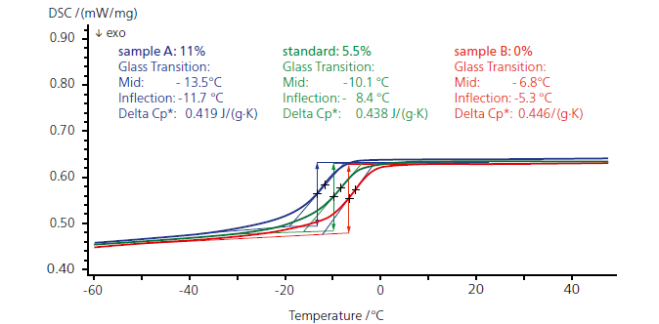

Slide 33
Curing Reaction
Polycondensation of Phenolic Resin
The curing reaction of phenolic resins is caused by polycondensation. The endothermal release of the polycondensation products overlaps the exothermal curing. In such cases, curing can only be investigated with standard DSC measurements using autoclaves, or with high-pressure DSC measurements

Slide 34
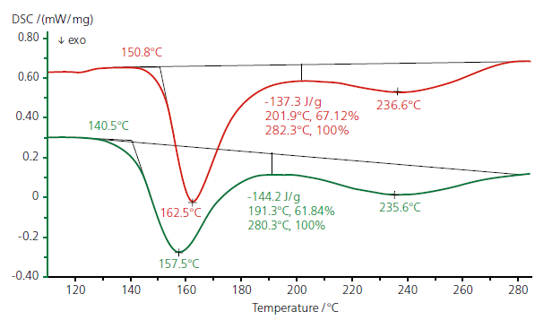

Slide 35
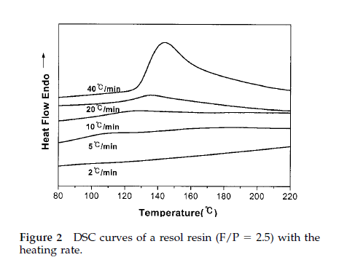
Curing Reaction-Activation Energy

Slide 36
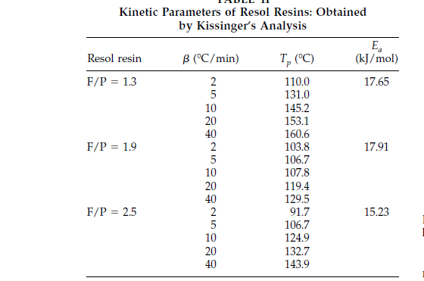

Slide 37
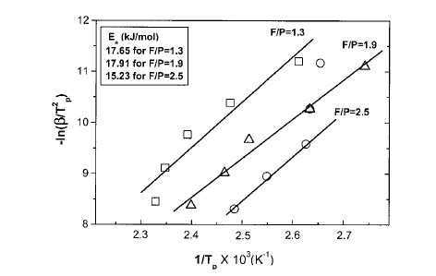

Slide 38
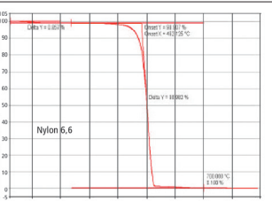
Characterization of Polymers by TGA
Thermal Stabilities and Moisture Content

Slide 39
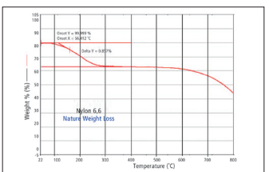
Thermal Stabilities and Moisture Content

Slide 40
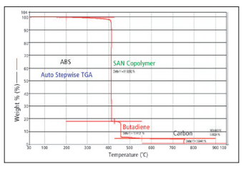
Compositional Analysis of Multi-component Polymers

Slide 41
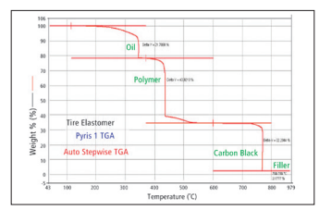
Measurement of Low Level of Volatiles

Slide 42
Characterization of Polymers by FTIR
infrared (IR) spectroscopy is ideally suited to qualitative analysis of polymer starting materials and finished products as well as to quantification of components in polymer mixtures and to analysis of in-process samples. The IR spectrum derives from absorption of light exciting molecular vibrations. The positions of absorption bands in the spectrum give information about the presence or absence of specific functional groups in a molecule and as a whole the spectrum constitutes a “fingerprint” that can be used to determine the identity of the sample. A difference between two spectra indicates that the two samples are made up of different components.

Slide 43
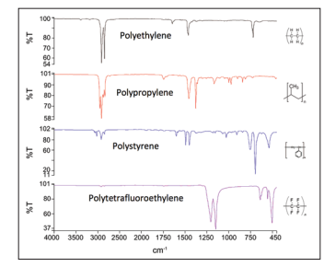

Slide 44
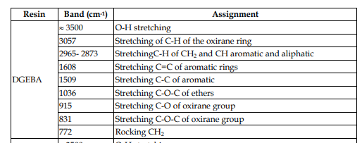
FTIR of Epoxy Resins

Slide 45
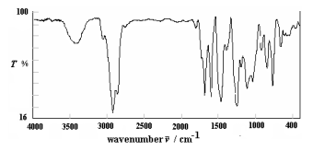

Slide 46
The epoxy value (w(Ep)) of resin was determined by analytical method [15]. This method was based on the back titration. 0.2 g of resin was added to 30 cm3 of 0.1 M-HCl and mixed for 2 h. Then unreacted HCl was re-titrated with phenolphthalein by standard alkali solution using the following formula
where V1 is the volume of NaOH solution used forblank and V2 is the volume of NaOH solution used for sample
Hydroxyl content was determined by acetylation with acetyl chloride in pyridine. The excess of acetyl chloride was decomposed with water and the resulting acetic acid, formed both in hydrolysis and in the acetylation process, was titrated with standard alkali using the following formula.

Slide 47
where V1 is the volume of KOH solution used for blank and V2 is the volume of KOH solution used for sample.
The chlorine content was determined by treating the resin solution with alcoholic KOH and titrating it against standard HCl

Slide 48
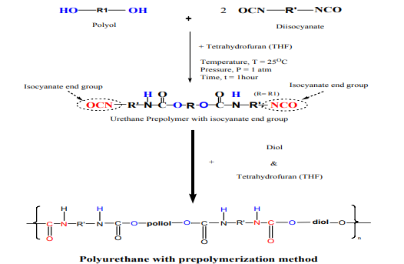
FTIR of Polyurethane

Slide 49
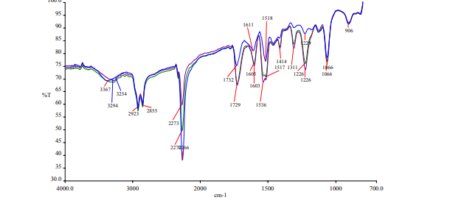

Slide 51
Question: Find and explain the characteristic bands of the polymers listed below:-
1- unsaturated polyester
2- phenolic resin type resol
3- siloxane resine ( PDMS )

